Slide 1

Review 1.3
B. Tech. Project (19ECE495)
Batch ID: 070
Mutual coupling reduction in MIMO Patch Antenna Array for Wi-Fi and Bluetooth applications
MENTOR: Ms. V. MEKALADEVI
Dept. of Elec. and Commn. Engg.
Amrita School of Engineering, Coimbatore
CB.EN.U4ECE22225 | - | J Rohith
CB.EN.U4ECE22262 | - | Peddakudala Yashwanth
CB.EN.U4ECE22213 | - | Chundupalle Tej Siddanth

Slide 2
MOTIVATION:
Growing Wireless Demand: Modern Wi-Fi and Bluetooth devices at 2.4 GHz require high data rates and reliable performance in compact systems.
Need for MIMO Technology: MIMO antenna arrays enhance data throughput and link reliability in multipath environments.
Problem of Mutual Coupling: Closely spaced antenna elements suffer from electromagnetic interaction, reducing isolation, efficiency, and diversity performance.
Design Challenge: Achieving high isolation and compactness simultaneously at 2.4 GHz is difficult due to limited element spacing.
Goal: To design a compact MIMO patch antenna array with effective mutual coupling reduction techniques (like DGS, EBG, or neutralization lines) for improved Wi-Fi and Bluetooth performance.

Slide 3
OBJECTIVE:
•Design and analysis of base antenna at 2.4 GHz.
•Design and analysis of Patch antenna array at 2.4 GHz.
•Design and analysis of Patch antenna array with decoupling structures.
•Prototype and Measurement.
Performance Targets:
•Isolation: > 20 dB between antenna elements
•Element Spacing: < λ/2 for compact design
•Operating Frequency: 2.4 GHz (Wi-Fi and Bluetooth bands)

Slide 4
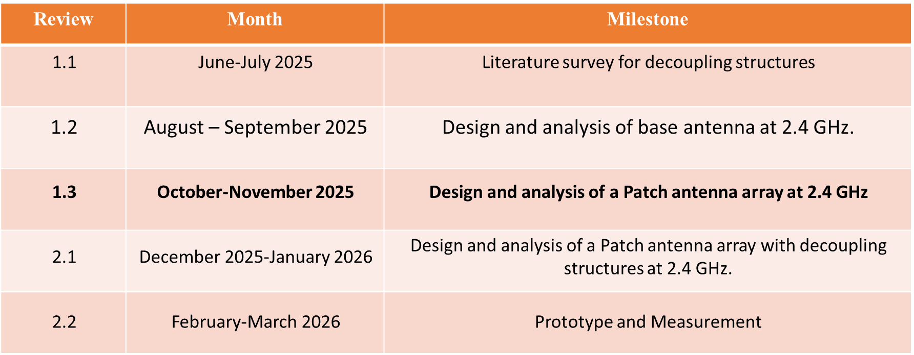
TIMELINE:

Slide 5
LITERATURE:
S.No. | Title of the paper | Source | Inferences
1 | Compact Self-Isolated Four-Element MIMO Antenna for WLAN and ISM Bands Application | IEEE Antennas and Wireless Propagation Letters, 2023 | Key Advantage of Proposed Work Self-isolation (no extra structures). Most compact (40 × 40 mm²) among compared works. Highest isolation (>20 dB) and lowest ECC (<0.02). Very good for portable WLAN/ISM devices. Limitations Lower gain (~2.8 dBi) compared to some dual/tri-band designs.
2 | Decoupling Between Extremely Closely Spaced Patch Antennas by Mode Cancellation Method | IEEE Antennas and Wireless Propagation Letters, 2024 | Key Advantage of Proposed Work Isolation: 5 dB → 15.4 dB+ (2.39–2.53 GHz). Better radiation: Gain 7.8 dBi, FBR 25 dB, low x-pol. High efficiency (82–87%), ECC < 0.004. Works for 1-D & 2-D arrays, simple + tiny size.

Slide 6
LITERATURE:
S.No. | Title of the paper | Source | Inferences
3 | Mutual Coupling Reduction of a Dual-Band Four-Port Patch Antenna With Co-Polarized Radiation Pattern by Controlling Electric Fields | IEEE Transactions on Antennas and Propagation, 2023 | Key Advantage of Proposed Work First dual-band, four-port, co-polarized patch antenna with low MC (< –15 dB) and single radiator. Compact + no extra feeding network. Limitations More design complexity (multiple pins + slots). Upper-band initially had non-broadside beam (fixed using pin 4).
4 | A Compact Multifrequency Broadband Dual-Antenna System With Mutual Coupling Reduction for Wi-Fi 6E Application | IEEE Transactions on Antennas and Wireless Propagation, 2024. | Key Advantage of Proposed Work Most compact design (shortest length). Achieves highest isolation (>22 dB). Covers all Wi-Fi bands including 6E (2.4 / 5 / 6–7 GHz). Maintains low ECC (<0.3) → better MIMO performance. Limitations Efficiency (40–50%) lower than some larger designs.

Slide 7
LITERATURE:
S.No. | Title of the paper | Source | Inferences
5 | Mutual Coupling Reduction in Dual-Band MIMO Antenna Using Parasitic Dollar-Shaped Structure for Modern Wireless Communication | IEEE Transactions on Antennas and Propagation, September 2023 | Key Advantage of Proposed Work Highest isolation (>30 dB) among compared designs. Lowest ECC (<0.02) → excellent diversity. Simple parasitic structure, compact design. Performance: Operating bands: 3.5 GHz (5G) and 5.2 GHz (WLAN). Isolation improved to >30 dB (without needing complex decoupling networks).

Slide 8
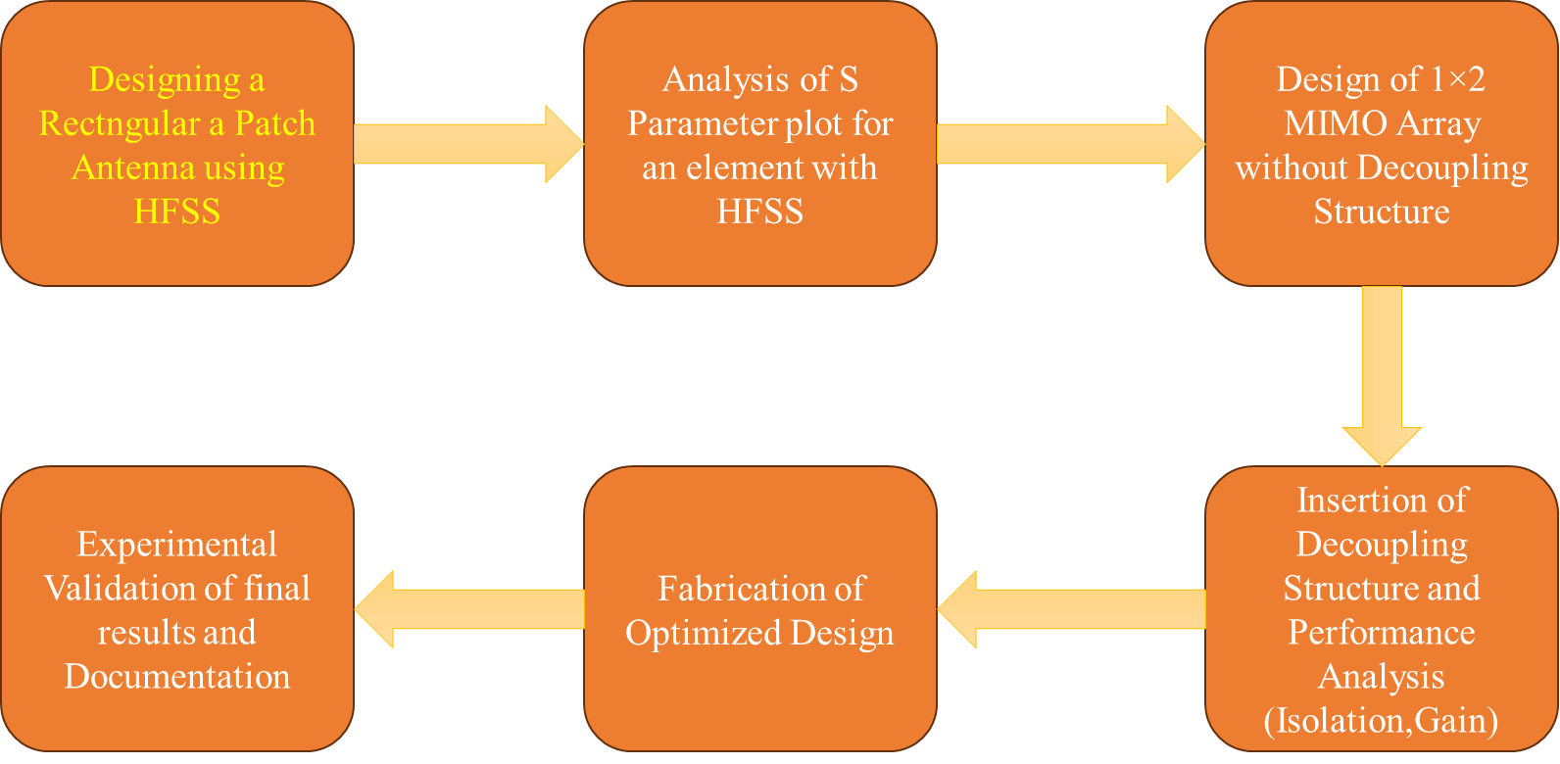
METHODOLOGY:

Slide 9
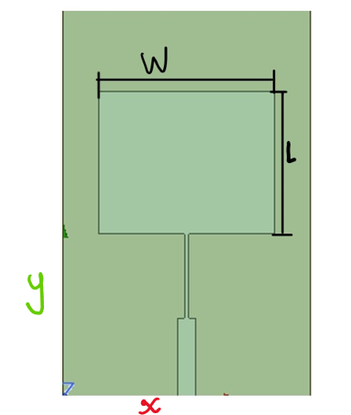
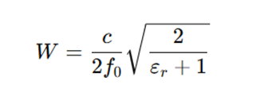
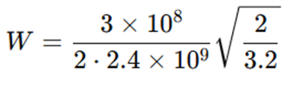
METHODOLOGY:
qPatch Antenna Dimension Calculation:
As the frequency of the application is 2.4 GHz, considering Rogers RT duroid 5880 (εr = 2.2) is a suitable substrate, the basic patch antenna dimensions are determined through mathematical calculations.
Designed for 2.4 GHz rectangular patch on Rogers RT duroid 5880(εr = 2.2) with h = 1.6 mm.
Patch Width(W):
…(1)
=> W = 49.38mm
Figure 1. Simulated model of a unit element of an Array

Slide 10

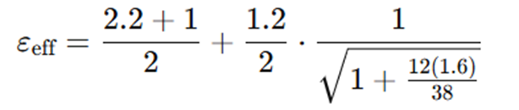

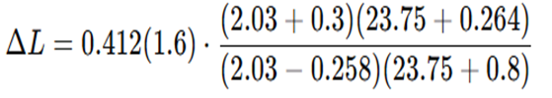
METHODOLOGY:
qPatch Antenna Dimension Calculation:
Effective Permittivity ε_{eff}
...(2)
=>εeff≈2.03
Fringing extension ΔL
...(3)
=> ΔL≈0.74mm

Slide 11



METHODOLOGY:
qPatch Antenna Dimension Calculation:
Effective length(L_{eff}):
...(4)
=> L_{eff} = 30.2mm
Physical length of patch:
...(5)
L=30.2-1.48 = 28.7mm

Slide 12
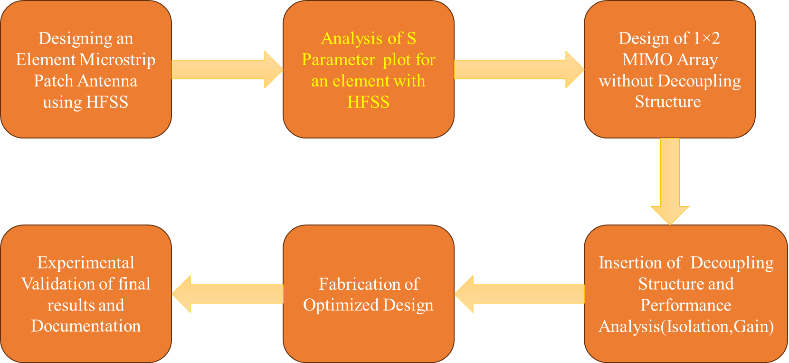
METHODOLOGY:

Slide 13
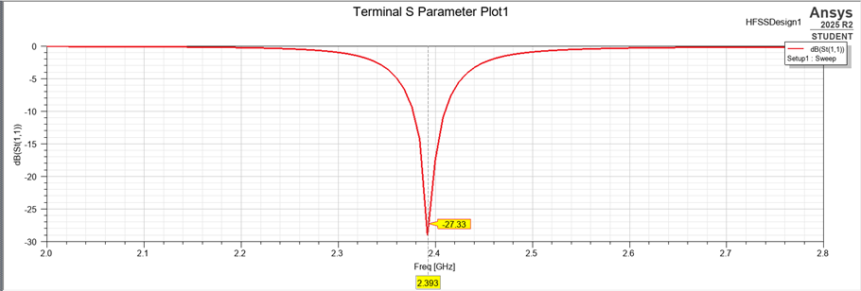
Results:
Analysis of the S-parameter plot for an element with HFSS.
Figure 2. Simulated S-parameter of a unit element

Slide 14
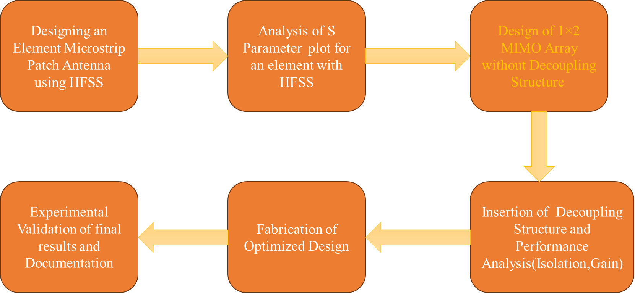
METHODOLOGY:

Slide 15
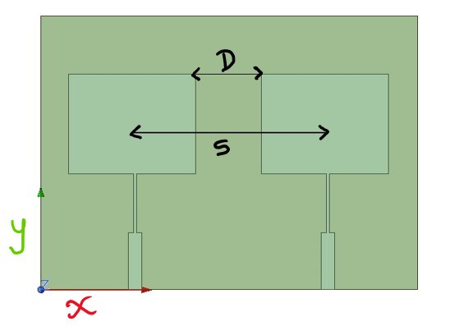
METHODOLOGY:
Design of 1×2 Patch antenna Array without Decoupling Structure:
The spacing between the centres of the two patches is chosen to be more than 0.5 λ₀ at 2.4 GHz.
This spacing is ideal because it helps the radiated waves from the two patches add constructively in the main lobe direction, enhancing the overall gain without creating unwanted grating lobes, also increasing isolation between the patches.
Variable | Value | Value In terms of λ₀
D(edge to edge) | 24.6 mm | 0.2 λ₀
S(centre to centre) | 71.4mm | 0.56 λ₀
Figure 3.1×2 Patch antenna Array
Table 1 : Spacing between the antennas

Slide 16
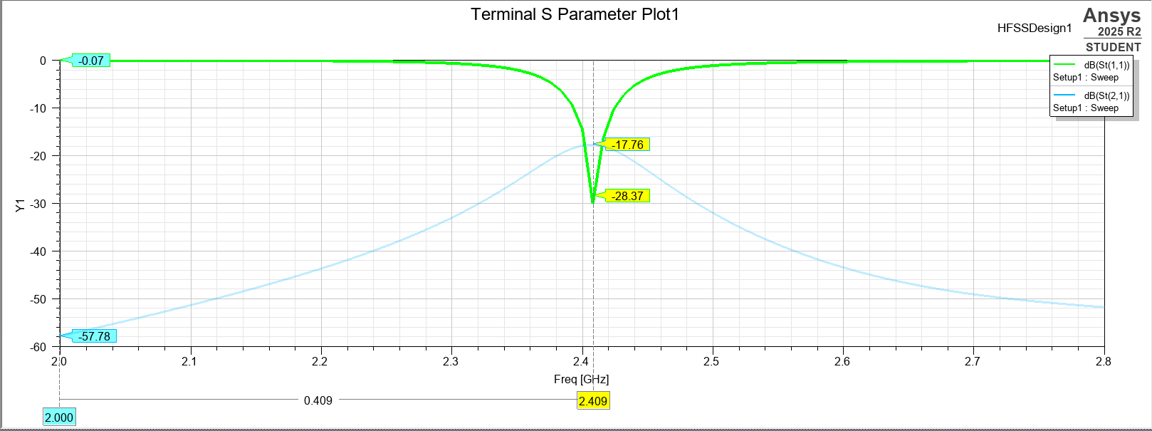
Results:
Analysis of the S-parameter plot for 1×2 Patch antenna Array without a Decoupling Structure with HFSS with centre to centre spacing as 0.56 λ₀.
Figure 4. Simulated S11 of 1×2 Patch antenna Array

Slide 17
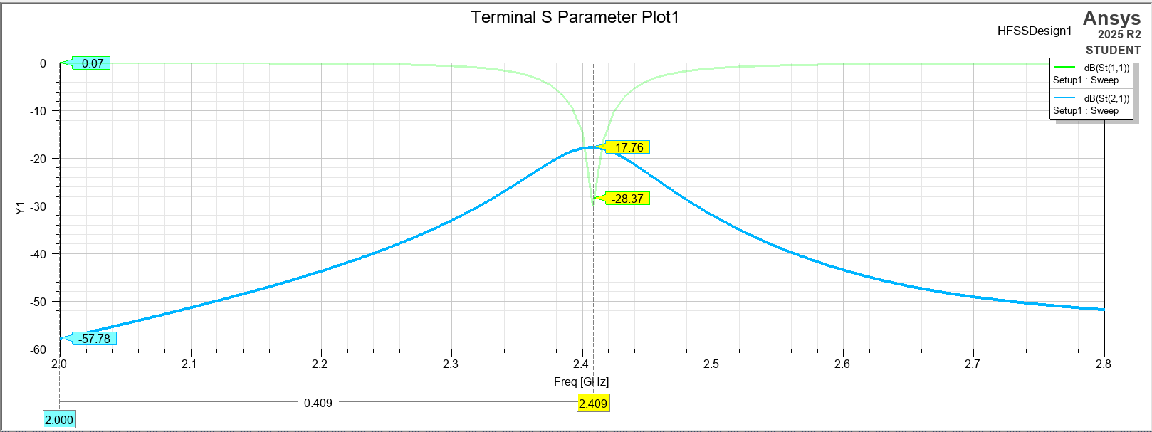
Results:
Analysis of the S-parameter plot for 1×2 Patch antenna Array without a Decoupling Structure with HFSS with centre to centre spacing as 0.56 λ₀.
Figure 5. Simulated S21 of 1×2 Patch antenna Array

Slide 18
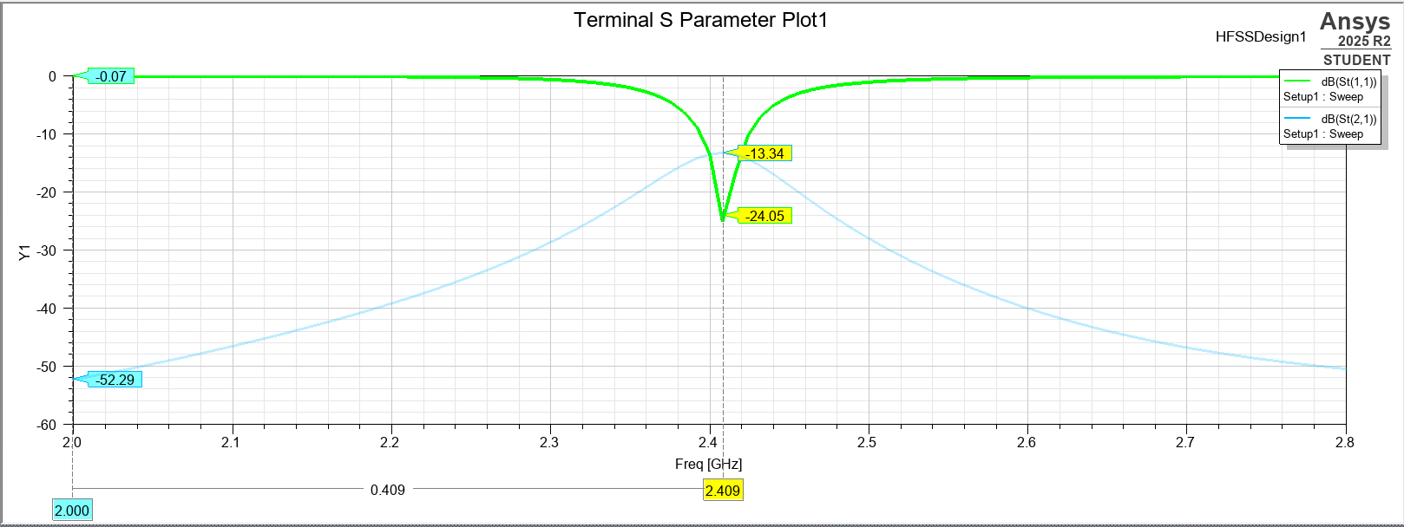
Results:
Analysis of the S-parameter plot for 1×2 Patch antenna Array without a Decoupling Structure with HFSS with centre to centre spacing as 0.5 λ₀.
Figure 6. Simulated S11 of 1×2 Patch antenna Array

Slide 19
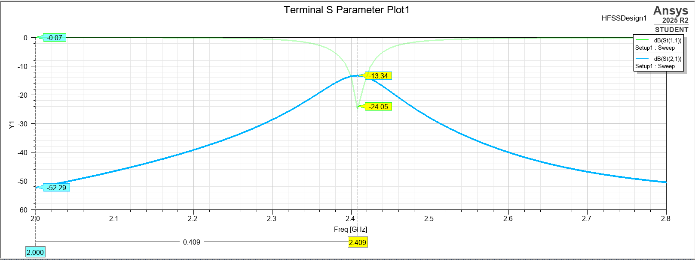
Results:
Analysis of the S-parameter plot for 1×2 Patch antenna Array without a Decoupling Structure with HFSS with centre to centre spacing as 0.5 λ₀.
Figure 7. Simulated S21 of 1×2 Patch antenna Array

Slide 20
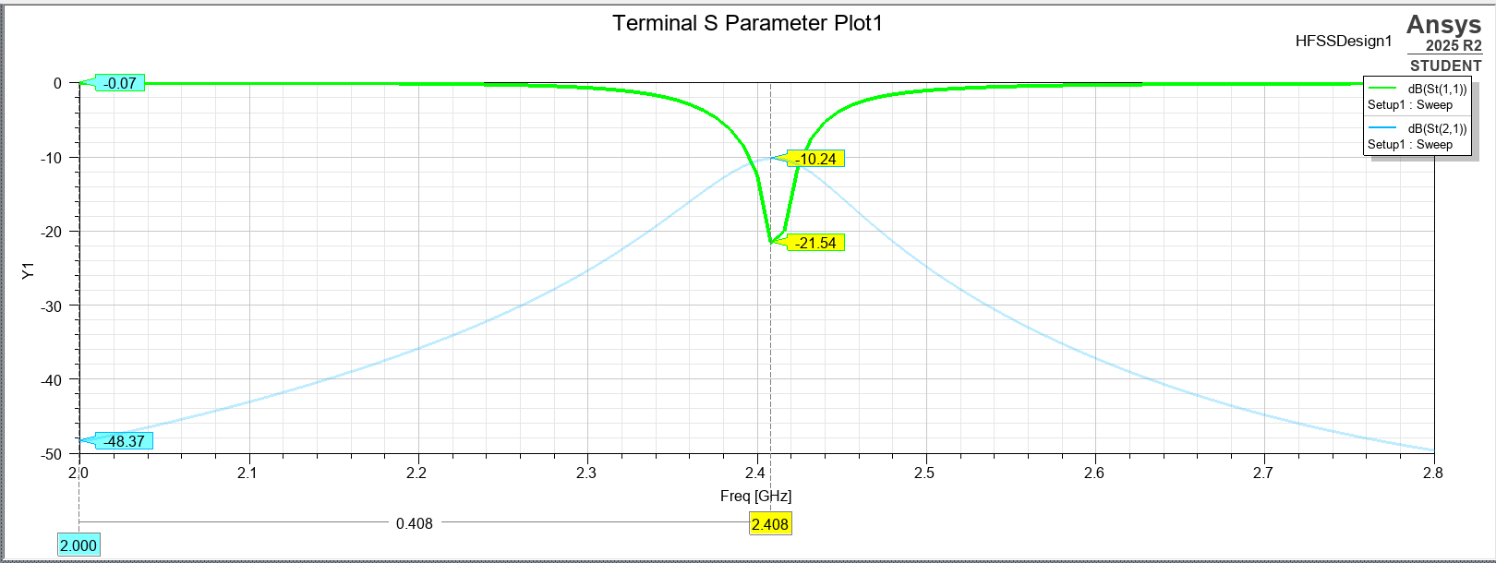
Results:
Analysis of the S-parameter plot for 1×2 Patch antenna Array without a Decoupling Structure with HFSS with centre to centre spacing as 0.45 λ₀.
Figure 8. Simulated S11 of 1×2 Patch antenna Array

Slide 21
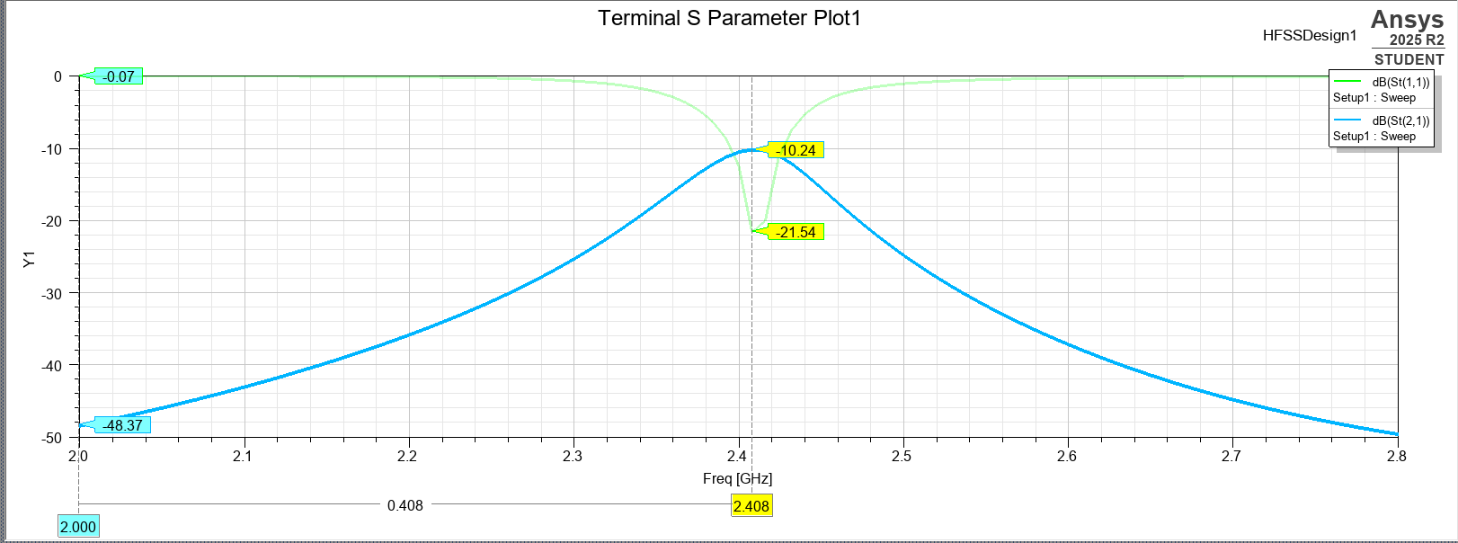
Results:
Analysis of the S-parameter plot for 1×2 Patch antenna Array without a Decoupling Structure with HFSS with centre to centre spacing as 0.45 λ₀.
Figure 9. Simulated S21 of 1×2 Patch antenna Array

Slide 22
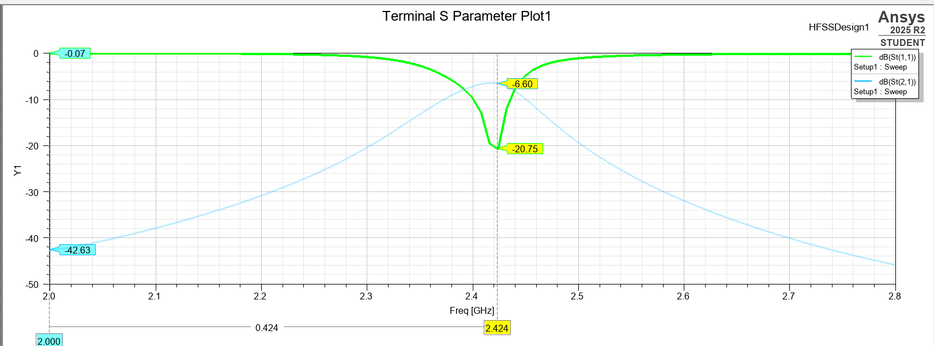
Results:
Analysis of the S-parameter plot for 1×2 Patch antenna Array without a Decoupling Structure with HFSS with centre to centre spacing as 0.4 λ₀.
Figure 10. Simulated S11 of 1×2 Patch antenna Array

Slide 23
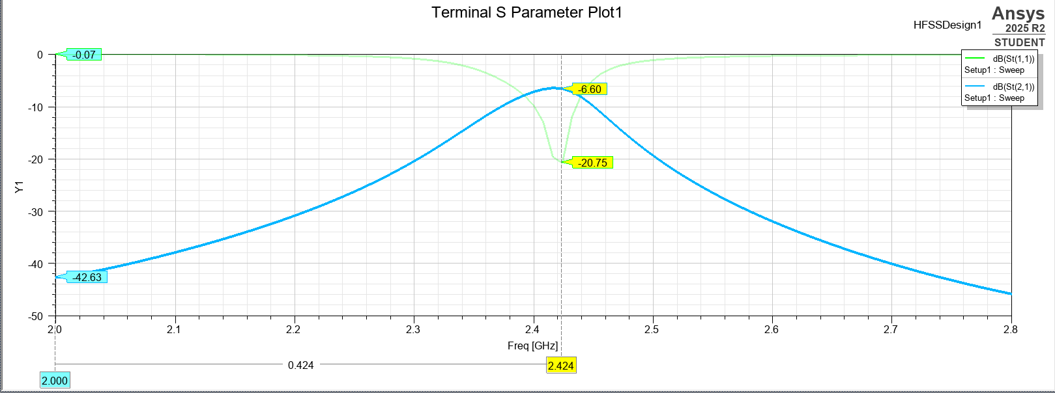
Results:
Analysis of the S-parameter plot for 1×2 Patch antenna Array without a Decoupling Structure with HFSS with centre to centre spacing as 0.4 λ₀.
Figure 11. Simulated S21 of 1×2 Patch antenna Array

Slide 24
REFERENCES:
[1] G. Yang, Y. Zhang, and S. Zhang, “Compact Self-Isolated Four-Element MIMO Antenna for WLAN and ISM Bands Application ,” IEEE Open J. Antennas Propag., vol. 2, pp. 203–213, 2023, doi: 10.1109/OJAP.2023.3057062.
[2] W.-L. Zhou, S.-W. Qu, M. Xia, and S. Yang, “Decoupling Between Extremely Closely Spaced Patch Antennas by Mode Cancellation Method ,” IEEE Trans. Antennas Propag., vol. 70, no. 11, pp. 10475–10484, Nov. 2024, doi: 10.1109/TAP.2024.3195454.
[3] A. Li, S.-W. Qu, and S. Yang, “ Mutual Coupling Reduction of a Dual-Band Four-Port Patch Antenna With Co-Polarized Radiation Pattern by Controlling Electric Fields ,” IEEE Antennas Wireless Propag. Lett., vol. 21, no. 9, pp. 1762–1766, Sept. 2022, doi: 10.1109/LAWP.2022.3179404.
[4] Y. Yang, Y. Feng, L.-K. Zhang, Z. Xing, and J. Li, “ A Compact Multifrequency Broadband Dual-Antenna System With Mutual Coupling Reduction for Wi-Fi 6E Application ,” IEEE Antennas Wireless Propag. Lett., vol. 23, no. 12, pp. 4074–4078, Dec. 2024, doi: 10.1109/LAWP.2024.3428515.
[5] Z.-L. Su, K. W. Leung, and K. Lu, “Mutual Coupling Reduction in Dual-Band MIMO Antenna Using Parasitic Dollar-Shaped Structure for Modern Wireless Communication,” IEEE Trans. Antennas Propag., vol. 70, no. 9, pp. 7659–7669, Sept. 2023, doi: 10.1109/TAP.2023.3199567.

Slide 25
Thank You

